Slide 1
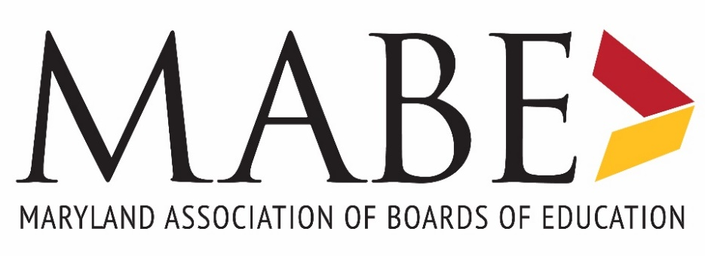
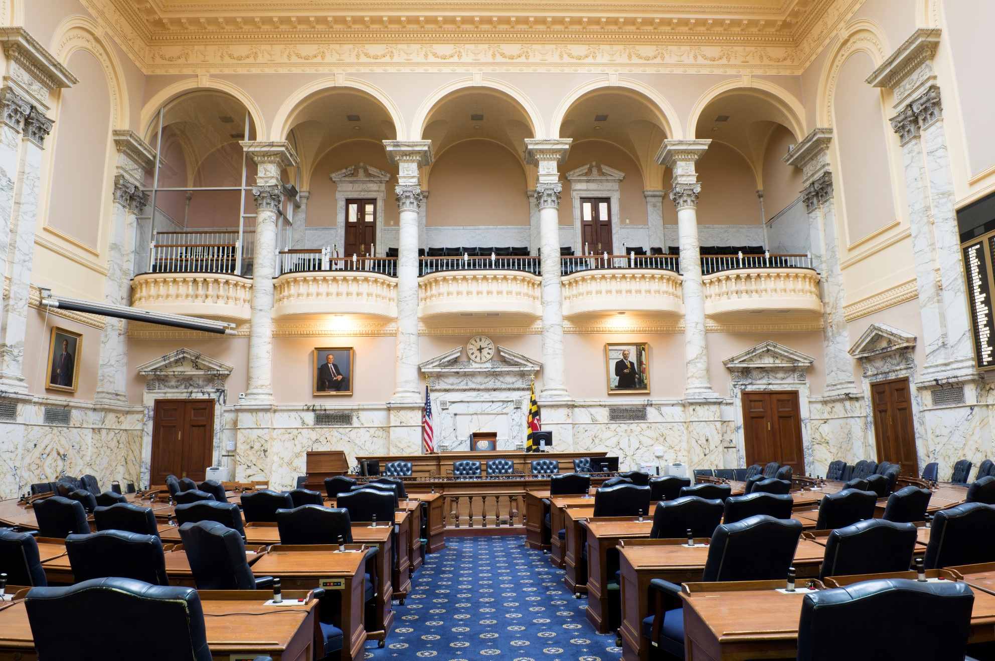
2020 Legislative Priorities & Forecast

Slide 2
MABE’s Legislative Priorities in 2020
MABE supports continued governance autonomy for local boards of education to set education policy and school budgets; and opposition to unfunded mandates; and is enhanced local school board calendar flexibility;
Supports full State funding for Maryland’s outstanding public schools; and passage of the Kirwan Blueprint legislation;
Supports at least $400 million in State funding for school facilities, and passage of the Built to Learn Act;
Supports sustained and increased local government investments in education.

Slide 3
The Kirwan Blueprint in 2019
SB 1030 – The Blueprint for Maryland’s Future
The bill provides targeted funding in FY 2020; and mandates funding increases in FY 2021 and FY 2022 – Totaling $1.1 billion.
Programs include: Full-Day Prekindergarten Funding, Teacher Salary Grants, Concentration of Poverty Grants, Special Education Funding, Teacher Collaborative Grants, Mental Health Coordinator Funding, and Supplemental Instruction Grants.
The bill did not include the Kirwan Commission’s recommended policy reforms or 10-year funding plan.

Slide 4
Kirwan Blueprint (SB 1030)
Inspector General
Establishes the Maryland Office of the Inspector General for Education, contingent on the Governor releasing FY 2020 funding to implement the bill.
The IG is responsible for examining local boards of education, local school systems, and public schools; nonpublic schools that receive State funds; MSDE; and the Interagency Commission on School Construction.
The IG’s office may investigate complaints of fraud, waste, and abuse involving the use of public funds; violations of the civil rights of students and employees; and other violations of law.

Slide 5
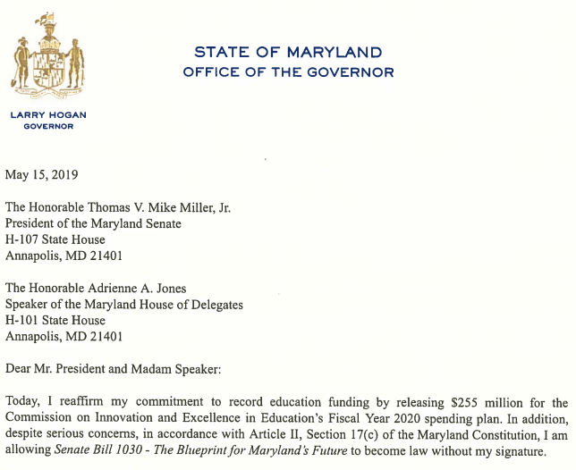
Kirwan Blueprint (SB 1030)
Governor Hogan Agrees to Fund and Pass Kirwan
On May 15, 2019 Governor Hogan announced, via press release and letter to Senate President Mike Miller and House Speaker Adrienne Jones, his decision to release the full $255 million for the FY 2020 allocations of State funding for PreK, teacher salary grants, special education, and other programs contained in Senate Bill 1030, the Blueprint for Maryland’s Future.

Slide 6
Bills Passed in 2019
HB 87/SB 529 - State Board of Education - Membership - Teachers and Parent
HB 1019 - State Board of Education - Public High School Students - Assessments and Graduation Requirements
SB 734 - Students with Reading Difficulties - Screenings and Interventions
HB 725 - Student Discipline - Restorative Approaches
SB 568 (Ch. 53) - Crimes - Child Abuse and Neglect - Failure to Report
HB 486/SB 541 - Education - Personnel Matters - Child Sexual Abuse and Sexual Misconduct Prevention

Slide 7
State Board Membership
HB 87/SB 529 - State Board of Education - Membership - Teachers and Parent
Increases the membership of the State Board of Education from 11 to 13 regular members, totaling 14 including the student member.
Establishes procedures for the appointment of one certified teacher and one parent of a student enrolled in a public school.
This bill took effect June 1, 2019.
New board members to take office in Jan. 2020.

Slide 8
High School Assessments
HB 1019 - State Board of Education - Public High School Students - Assessments and Graduation Requirements
Establishes the restriction that the State Board may only require a passing score on a standardized assessment to evaluate a student for graduation from high school after the assessment has been field-tested and piloted for at least 1 year.
The bill took effect July 1, 2019.

Slide 9
Reading Ability Screenings and Interventions
SB 734 - Students with Reading Difficulties - Screenings and Interventions
Requires, beginning with the 2020-2021 school year, each local board to ensure that students are screened to identify if the student is at risk for reading difficulties.
If the screening results indicate that the student is at risk of reading difficulties, schools must provide supplemental reading instruction, and provide a notification letter to the student’s parent.
MSDE must develop resources for local boards every four years to support local training.
Local boards must report annually to MSDE beginning with the 2020-2021 school year.
The bill took effect July 1, 2019.

Slide 10
Student Discipline Reform
HB 725 - Student Discipline - Restorative Approaches
Requires local board regulations related to discipline to provide for restorative approaches and state that the primary purpose of any disciplinary measure is rehabilitative, restorative, and educational.
The bill took effect July 1, 2019.

Slide 11
Criminal Penalty for Failure to Report
SB 568 (Ch. 53) - Crimes - Child Abuse and Neglect - Failure to Report
This bill makes failure to report a misdemeanor for a person who is required to provide notice of suspected abuse or neglect of a child under § 5–704 of the Family Law Article, if the person has actual knowledge of the abuse or neglect.
Upon conviction, a violator is guilty of a misdemeanor and subject to a fine not exceeding $10,000 or imprisonment not exceeding 3 years, or both.
The bill took effect October 1, 2019.

Slide 12
Sexual Abuse Prevention
HB 486/SB 541 - Education - Personnel Matters - Child Sexual Abuse and Sexual Misconduct Prevention
This bill sets forth a process and requirements for specific documentation regarding whether an individual has ever been investigated for allegations of “child sexual abuse” or “sexual misconduct,” for the hiring of public school and nonpublic school employees who have direct contact with minors.
The bill took effect July 1, 2019.

Slide 13
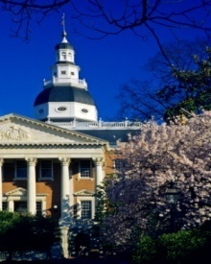
2020 Session Forecast
Kirwan Blueprint Legislation
Funding Formulas
Policy Reforms
Revenue Sources
School Construction Bills
Special Education Bills
Collective Bargaining Bills
Student Discipline/Restorative Practices Bills

Slide 14
The Built to Learn Act
The Built to Learn Act (HB 1/SB 1)
Modified reintroduction of the Build to Learn Act of 2019 (HB 727).
This bill authorizes the Maryland Stadium Authority (MSA) to issue up to $2.2 billion in revenue bonds, backed by annual payments from the Education Trust Fund (ETF) beginning in fiscal 2021, for public school construction projects in the State.
The bill allocates proceeds from the revenue bonds among local schools systems, including to support the public-private partnership (P3) agreement for Prince George’s County.

Slide 15
Special Ed. Expert Witness Fees
Special Education - Administrative Proceedings and Judicial Actions - Attorney's and Expert Witness Fees and Related Costs
This bill would have authorized a court to award reasonable expert witness fees to the parent who is the prevailing party in these hearings.
2019 Status: HB 140 passed in the House, but received an Unfavorable Report by the Senate Education, Health, and Environmental Affairs Committee.
To be reintroduced in 2020.

Slide 16
2020 Session – Kirwan Legislation
A “Full Kirwan” bill needs to pass to:
Reform education policy to reflect the elements of the Kirwan “Call to Action” in the Interim Report;
Reform education funding formulas to increase per pupil funding for all students (foundation) and special needs groups: Limited English Proficient, Special Education, Economically Disadvantaged, and Concentrated Poverty;
Reform State and local funding shares; and
Mandate annual increases in State and local funding amounts for FY 2022 and beyond through 10-year phase-in.

Slide 17
Advocacy Tools for the Kirwan Blueprint
Blueprint Talking Points - 10 talking points on a convenient 5X7 postcard
The Value of the Blueprint in One Page - A one-page document that outlines easy to understand concepts on the importance of the Blueprint
Kirwan Business Leaders & the ROI - An outline of what Maryland business leaders are saying about Kirwan and the return on investment
An Economic Assessment of Kirwan Commission Recommendations - A study written by Sage Policy Group Inc.

Slide 18
John R. Woolums, Esq.
Director of Governmental Relations
Maryland Association of Boards of Education
621 Ridgely Avenue, Suite 300
Annapolis, MD 21401
O: (410) 841-5414
C: (410) 570-7365
www.mabe.org

